Slide 1
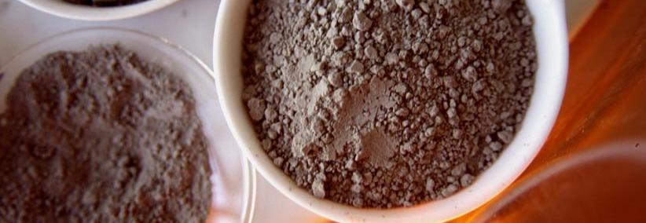
Separators / Classifiers
Technical Development Program for Process Performance Engineer

Slide 2
Content
Objectives and Overview
Air classification (air separation)
Operating principle and Design Features
Separator arrangement in the circuit
Key figures of classification
Particle Size Distribution (PSD) / RRSB
Circulating load u
Tromp Curve t_{r}
B – level audit of separator (measurement tasks and requirements)
Classifier Operation
Conclusion

Slide 3
Content
Objectives and Overview
Air classification (air separation)
Operating principle and Design Features
Separator arrangement in the circuit
Key figures of classification
Particle Size Distribution (PSD) / RRSB
Circulating load u
Tromp Curve t_{r}
B – level audit of separator (measurement tasks and requirements)
Classifier Operation
Conclusion

Slide 4
Objectives and Overview
Understand the basic principles of classification
Become familiar with the design features, operating principles and typical circuit arrangements
Learn how to interpret a Particle Size Distribution and a Tromp Curve and how to calculate the circulating load
Understand the operational parameters of Air Separators

Slide 5
The Comminution Process Chain
Crushing
Drying
Coarse grinding
Fine grinding
Classification
Grinding tool management
Ventilation & cooling
Operation
Control

Slide 6
Content
Objectives and Overview
Air classification (air separation)
Operating principle and Design Features
Separator arrangement in the circuit
Key figures of classification
Particle Size Distribution (PSD) / RRSB
Circulating load u
Tromp Curve tr
B – level audit of separator (measurement tasks and requirements)
Classifier Operation
Conclusion

Slide 7

Operating Principle and Design Features
Terminology of Classification Process
(note that different words are used for the same)
Fines (F)
Fine Fraction
Product
Screen
Feed (A)
Incoming Flow
Rejects(R)
Coarse Fraction
Tailings

Slide 8
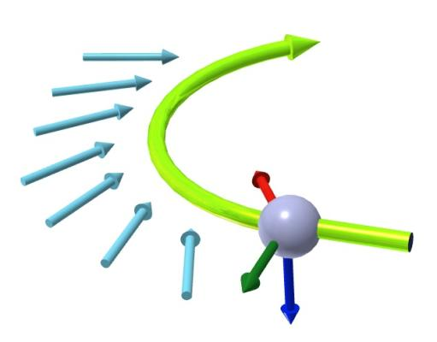
Operating Principle
Material particles are exposed to a spiral air vortex
On the spiral path, the particles are exposed to 3 main forces:
Drag force of air or gas F_{D}
Centrifugal force F_{C}
Gravity F_{G}
F_{D}
Spiral air vortex
F_{C}
F_{G}

Slide 9
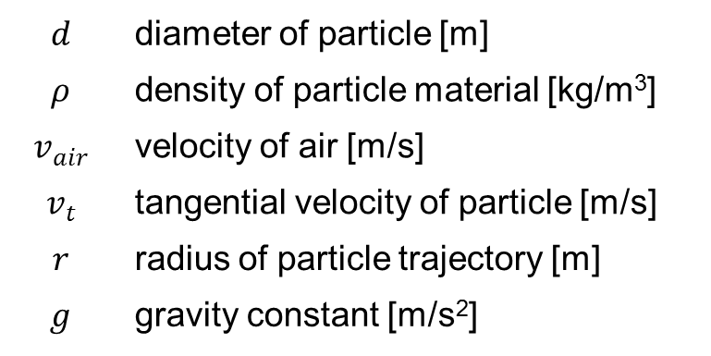
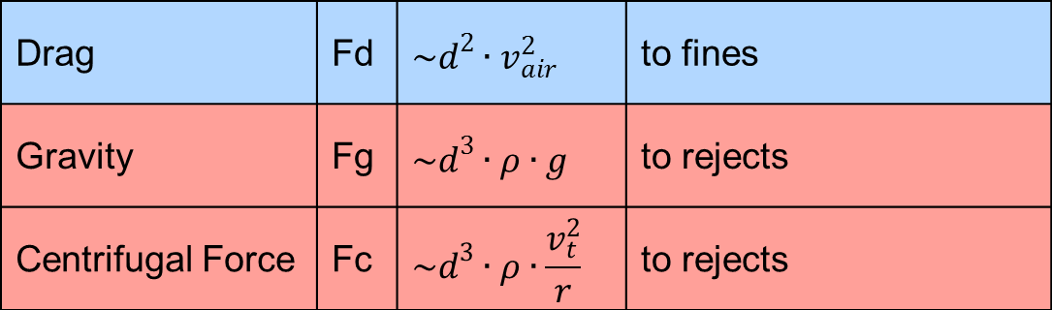
Operating Principle
Gravity and centrifugal force tend to bring particles to the rejects, while drag force brings them into the fines.
Drag | Fd | $$\sim d^{2}∙v_{air}^{2}$$ | to fines
Gravity | Fg | $$\sim d^{3}∙ρ∙g$$ | to rejects
Centrifugal Force | Fc | $$\sim d^{3}∙ρ∙\frac{v_{t}^{2}}{r}$$ | to rejects
$$d$$ | diameter of particle [m]
$$ρ$$ | density of particle material [kg/m³]
$$v_{air}^{}$$ | velocity of air [m/s]
$$v_{t}^{}$$ | tangential velocity of particle [m/s]
$$r$$ | radius of particle trajectory [m]
$$g$$ | gravity constant [m/s²]

Slide 10
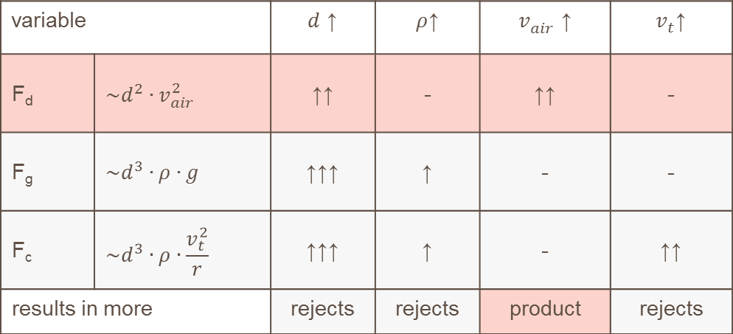
Operating Principle
The fraction of fines (product), respectively coarse (rejects) is influenced by the following variables:
The smaller and the lighter a particle, the more likely it is taken into the fines.
variable |  | ↑$d$ | ↑$ρ$ | ↑$v_{air}^{}$ | ↑$v_{t}^{}$
F_{d} | $$\sim d^{2}∙v_{air}^{2}$$ | ↑↑ | - | ↑↑ | -
F_{g} | $$\sim d^{3}∙ρ∙g$$ | ↑↑↑ | ↑ | - | -
F_{c} | $$\sim d^{3}∙ρ∙\frac{v_{t}^{2}}{r}$$ | ↑↑↑ | ↑ | - | ↑↑
results in more |  | rejects | rejects | product | rejects

Slide 11

Operating Principle
Example Cyclone:
The particles enter the vortex together with the air.
The heavy and coarse particles are centrifuged
towards the wall and drop down to the rejects
due to gravity. The fine and light particles are carried out
to the fines by the air stream.
fines
feed
immersion tube
cylindrical part
conical part
rejects

Slide 12
Design Features
Classifiers
static
dynamic
1st Generation
2nd Generation
3rd Generation
Grit Separator
V-separator
Cyclone
Overview of Air Classifier Types
No moving parts
Fineness control by mechanical adjustment
Counter blades, distributor plate and internal fan
Fineness control: by mechanical adjustment or counter blade speed change
Same as 1st generation, but external fan and cyclones
Cage rotor with variable speed drive
External fan
Fineness control by rotor speed

Slide 13
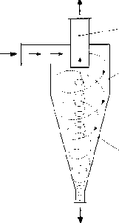
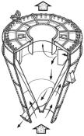
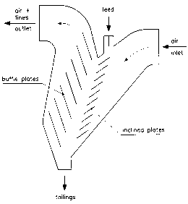
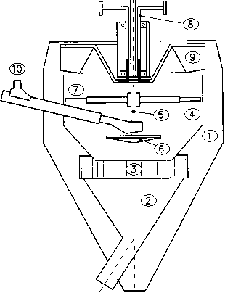
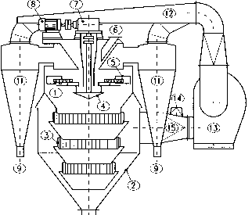
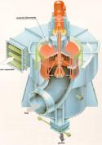
Design Features
Classifiers
static
dynamic
1st Generation
2nd Generation
3rd Generation
Grit Separator
V-Separator
Cyclone
Overview of Air Classifier Types
no moving parts
with moving parts
Or HES: High Efficiency Separator

Slide 14
Classifier Arrangement in the Circuit
Single Pass
Cyclone
There are two basic arrangements of classifiers:
to stack
main gas flow
main gas flow
Higher drying and cooling capacity
Big filters required
Lower investment
Lower space requirement
Limited drying and cooling capacity

Slide 15
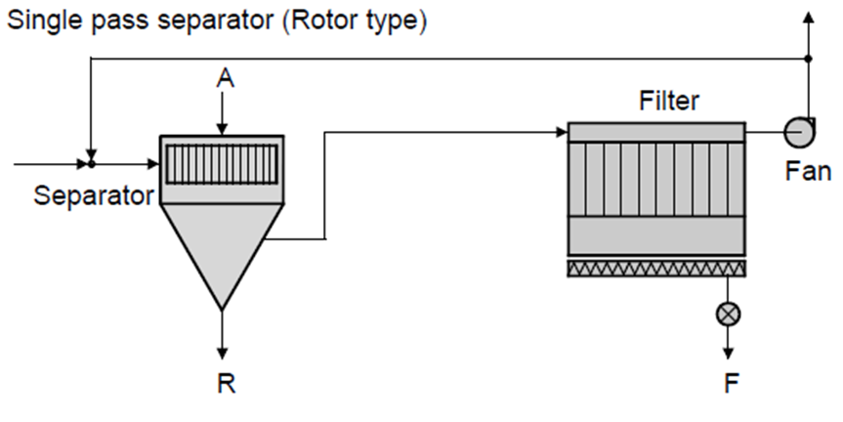
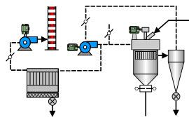
Purpose of Classifier Ventilation
Keeping the classifier at negative pressure
Material cooling (depending on dedusting system design)
Removing of fines (otherwise circuit will be saturated with fines)
 | Single pass system | Cyclone air system
Amount of fresh air in relation to classifier air | 100 % | ~10 – 15 %
Cooling potential* | 30 – 40 °C | 5 – 10 °C
*@ 0.7 Nm³_{separator air} / kg _{product}

Slide 16
Content
Objectives and Overview
Air classification (air separation)
Operating principle and Design Features
Separator arrangement in the circuit
Key figures of classification
Particle Size Distribution (PSD) / RRSB
Circulating load u
Tromp Curve t_{r}
B – level audit of separator (measurement tasks and requirements)
Classifier Operation
Conclusion

Slide 17
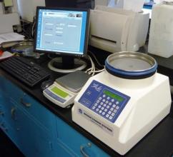
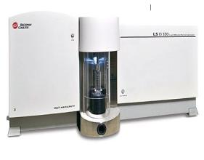
Key Figures - Particle Size Distribution (PSD)
The PSD shows how many particles of each size class are present in bulk material.
The PSD is measured by sieving or by laser granulometry
Ranges:
Sieve Analysis
Laser Granulometry
Laboratory [µm] | 10 – 20’000 | 0.01 – 2’000
Industrial screen [µm] | 100 – 100’000 | 0.01 – 2’000

Slide 18
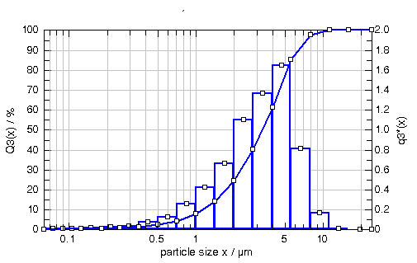
Key Figures - Particle Size Distribution (PSD)
The particle size distribution can either show the mass fraction of the different particle size classes (histogram) or the cumulative PSD (sum curve).
25
20
15
10
5
0
histogram
cumulative PSD
passing [%] (cumulative PSD)
mass fraction of particle size class [%] (histogram)
source: http://www.sympatec.com/Science/Characterisation/02_ParticelSizeDistribution.html

Slide 19
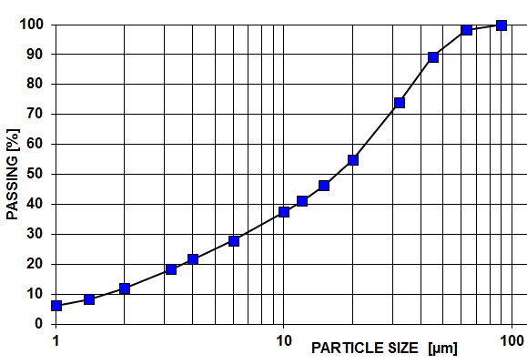
Key Figures - Particle Size Distribution (PSD)
For product description only the cumulative PSD is used:
cumulative PSD
Note: The y-axis can also show residues instead of passing

Slide 20
Key Figures – RRSB Diagram
In the Rosin-Rammler-Sperling-Bennet (RRSB) diagram, the cumulative PSD is displayed in form of a double logarithmic y-axis and logarithmic x-axis
99.9
99.9
99
99
95
95
Passing [%]
90
90
n = slope of the straight line [-]
For x = x’ = characteristic diameter, that 63.2 % of all particles pass
80
80
63.2
63.2
50
50
40
40
30
30
n = 0.74
20
n = 0.74
20
x’= 19.6 um
x
‘
= 19.6
µ
Slope
m
10
10
Characteristic Diameter
5
5
4
4
3
3
2
2
1
1
1
1
1.5
1.5
2
2
3
3
4
4
6
6
8
8
12
12
16
16
24
24
32
32
48
48
64
64
96
96
128
128
200
200
Particle size [um]

Slide 21
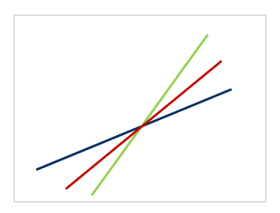
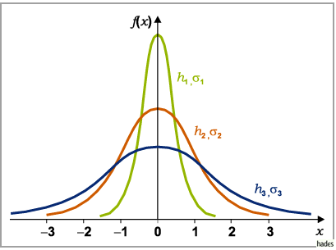
Key Figures – RRSB Diagram
In this Rosin-Rammler-Sperling-Bennet (RRSB) diagram, the cumulative PSD converts into a straight line, if the PSD is normally distributed (normal distribution valid for pure materials, like OPC, slag, limestone, etc.). The slope of the straight line is a measure for how narrow a particle size distribution is.
f(x)
=
Histogram of a normally distributed PSD
x
Cumulative PSD in the RRSB

Slide 22
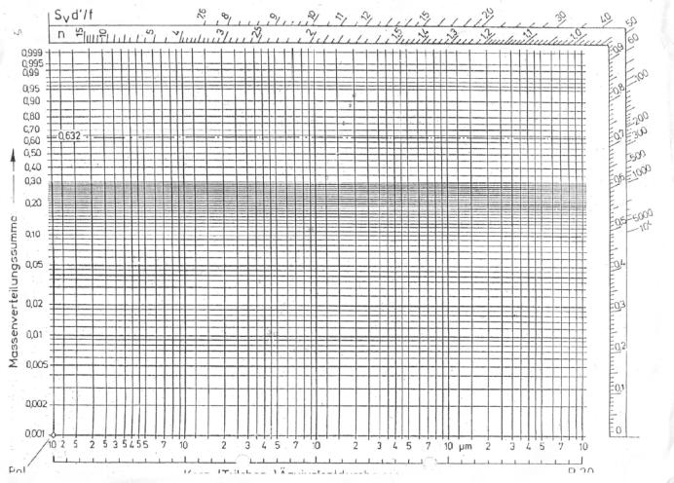
Key Figures – RRSB Diagram
n=1.2
Actual PSD
Move actual PSD parallel through pole to get the slope n of the PSD
pole

Slide 23
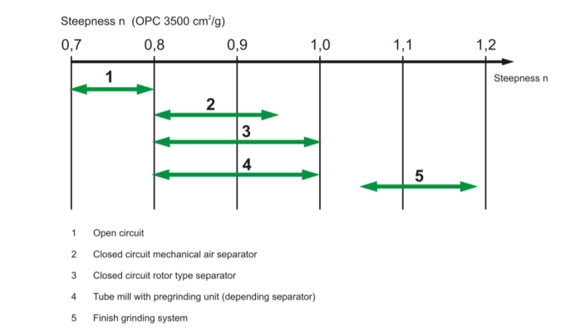
Key Figures – RRSB Diagram
The slope of the PSD in the RRSB diagram depends on the type of grinding system
Open circuit Tube Mill
Closed circuit Tube Mill with 1st & 2nd generation separator
Closed circuit Tube Mill with 3rd generation separator
Vertical Roller Mill / Tube Mill with pregrinding unit (depending on separator)
Finish grinding system (e.g. Roller Press)

Slide 24
Key Figures – Circulation Load u
The circulating load u describes how many times the material passes on average through the classifier, before it is sent to the fines.
It is defined as the ratio of the Classifier Feed A to the Fines F:
The circulating load u can be calculated by:
Physical weighting of the classifier Rejects R and the Fines F (in this case the Fines F are equal to the fresh feed (production rate) at stable operation)
PSDs of Classifier Feed A, Rejects R and Fines F

Slide 25

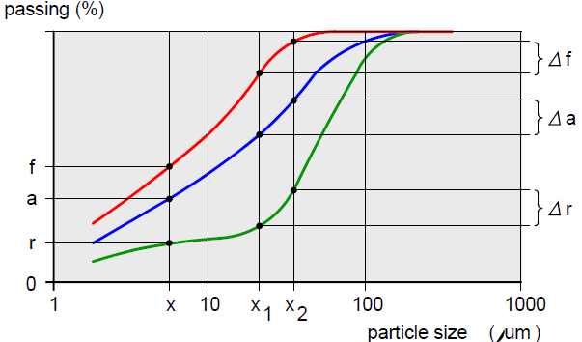
Key Figures – Circulation Load u
The mass balance is:
Fines (F)
The content balance is
for all size fractions < x_{i} µm
for all size fractions > x₁ and < x₂
Feed (A)
Rejects (R)
Symbols | mass flow [t/h] | mass fraction < x µm [%] | mass fraction >x₁ and <x₂ µm [%]
Separator feed | A | a | Δa
Fine fraction | F | f | Δf
Coarse fraction | R | r | Δr

Slide 26
Key Figures - Circulating Load u
Combining the circulating load formula and the content balance formula
circulating load formula
content balance formula
leads to the following circulation load formula:
a = mass fraction in feed < x [µm]
f = mass fraction in fines < x [µm]
r = mass fraction in rejects < x [µm]
To minimize possible sources of errors, in Holcim the circulating load is calculated with the sums of the respective passings or residues at the sieve sizes x_{i} :
a_{i} = mass fraction in feed < x_{i} [µm] (or > x_{i} [µm])
f_{i} = mass fraction in fines < x_{i} [µm] (or > x_{i} [µm])
r_{i} = mass fraction in rejects < x_{i} [µm] (or > x_{i} [µm])
x_{i} = sieve size [µm]

Slide 27
Key Figures – Tromp Curve t_{r}
The Tromp Curve t_{r} assesses the efficiency of separation.
It describes the “recovery efficiency per size class”, i.e. how much of the incoming feed of a given size class is recovered into the rejects of the same size class.
100%
70% of 10 µm particles end up in the fines
30%
30% of 10 µm particles end up in the rejects
0%
1
10
100
Particle size (µm)

Slide 28
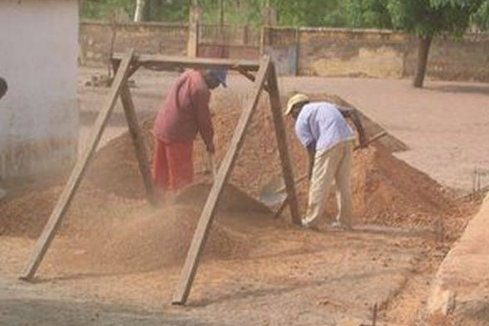
Key Figures – Tromp Curve t_{r}
Example: Separation or classification with a sieve

Slide 29


Key Figures – Tromp Curve t_{r} – perfect screen
Example: Separation or classification, if screen and sieving are perfect
A
F
R

Slide 30
Key Figures – Tromp Curve t_{r} C – perfect screen
Example: Separation or classification, if screen and sieving are perfect (in this example sieve opening size is 50 µm)
100%
Below 50 µm, all particles end up in the fines
Above 50 µm, all particles end up in the rejects
0%
1
10
50µm
100
Particle size X (µm)

Slide 31
Key Figures – Tromp Curve t_{r} – bypass
Example: Separation or classification, if screen and sieving have a bypass of fine particles to the rejects
Direct by-pass
Agglomeration

Slide 32
Key Figures – Tromp Curve t_{r} – bypass
Example: Separation or classification, if screen and sieving have a bypass of fine particles to the rejects
100%
Effect of agglomeration
20% direct by-pass
0%
1
10
50µm
100
Particle size X (µm)

Slide 33
Key Figures – Tromp Curve t_{r} – sharpness of separation or imperfection
Example: Separation or classification, if screen and sieving have no sharp separation and are imperfect and coarse particles can pass to the fines
Some holes are bigger than the nominal cut size

Slide 34
Key Figures – Tromp Curve t_{r}– sharpness of separation or imperfection
Example: Separation or classification, if screen and sieving have no sharp separation and are imperfect and coarse particles pass to the fines
100%
For particles slightly above 50 µm, a certain quantity can be found in the fines
0%
1
10
50µm
100
Particle size X (µm)

Slide 35
Key Figures – Tromp Curve t_{r}
Example: Real PSD and Tromp curve t_{r}

Slide 36
Key Figures - Tromp Curve t_{r}
The Tromp curve t_{r} describes, how much of the incoming feed of a given size class A⋅Δa is recovered into the rejects of the same size class R⋅Δr.
The Tromp value t_{r} for each size class is:
Δa: feed mass fraction >x1 and <x2 µm [%]
Δr: feed mass fraction >x1 and <x2 µm [%]
A: feed mass flow [t/h]
R: reject mass flow [t/h]

Slide 37
Key Figures - Tromp Curve t_{r} – main parameters
By Pass:
Lowest percentage of feed that will go to the separator rejects
Sharpness of separation or Imperfection:
Number characterizing the slope of the selection line
Sharpness of separation (Holcim)
k = d₇₅ / d₂₅
Imperfection (Lafarge)
I = (d₇₅ - d₂₅) / (2 x d₅₀)
d₇₅
d₅₀
Bypass
31 %
Cut point d₅₀ :
50 % of the feed go to the rejects 50 % of the feed go to the fines
d₂₅
Notes:
Y- axis can show residues as well as fines.

Slide 38
Key Figures - Tromp Curve t_{r}
Root causes for high bypass and poor sharpness of separation
 | Classifier
Bypass (fines in coarse fraction) | Feed material overload of classifier [kg/m³] Poor feed distribution in separating area Poor air distribution across rotor height (uneven velocity profile of air) Poor feed material dispersion (moisture, agglomeration,…)
Sharpness of separation | Poor air distribution across rotor height (uneven velocity profile of air)
Coarse in fine fraction | Poor condition of dynamic seal

Slide 39
Content
Objectives and Overview
Air classification (air separation)
Operating principle and Design Features
Separator arrangement in the circuit
Key figures of classification
Particle Size Distribution (PSD) / RRSB
Circulating load u
Tromp Curve t_{r}
B – level audit of separator (measurement tasks and requirements)
Classifier Operation
Conclusion

Slide 40
B – Level Audit (Tasks & Frequency)
B-level audit Realization
one year
1. Circuit mat. granulometry
2. Mill longitudinal sieving
3. Ball charge filling degree
4. Mill material level
5. Mill internal conditions
B – level audit measurements
6. Mill ventilation
B-level audit
7. Classifier ventilation
8. Classifier Tromp curve
9. Weigh feeder calibration
10. Instrument verification
11. Control loop verification
yearly stop

Slide 41
Classifier Operating Point (1/2)
B-level audit Realization
Typical circulation loads vs. fineness
High
Normal
Low

Slide 42
Classifier Operating Point (2/2)
B-level audit Realization
Typical bypass rates vs. circulation loads (and optimization potential)
High potential
Medium potential
Low potential

Slide 43
Content
Objectives and Overview
Air classification (air separation)
Operating principle and Design Features
Separator arrangement in the circuit
Key figures of classification
Particle Size Distribution (PSD) / RRSB
Circulating load u
Tromp Curve t_{r}
B – level audit of separator (measurement tasks and requirements)
Classifier Operation
Conclusion

Slide 44
Classifier Operation
Classifier Circulating Load u
Circulation load u increases with increased fineness
Particles have to be ground more often in the mill to achieve the desired fineness
Circulation load u of the grinding system is mill system specific
The lower the grinding progress per pass the higher the circulation load
Circulation load u depends on the classifier performance, operation and design, bypass, etc.

Slide 45
Classifier Operation
Classifier Air Flow
The air flow [m³/h] and the classifier rotor dimensions define the radial velocity [m/s] through the rotor (higher radial air velocity requires higher rotor speed for the same fineness)
The lower the specific feed air load [kg/m³], the better the dispersion of the material in the air (low bypass)
A homogeneous air distribution (homogeneous air velocity profile) across the rotor height is key to achieve
Desired product fineness at lowest rotor speed
Low bypass

Slide 46
Classifier Operating Point (1/4)
B-level audit Realization
Iso - fineness line
3’500 cm²/g
More Air More Rotor Speed

Slide 47
Classifier Operating Point (2/4)
Bypass 3
Bypass 2
By pass 1
Bypass 1 > Bypass 2 > Bypass 3

Slide 48
Classifier Operating Point (3/4)
Rotor
Red dashed line: Design limit Fan / Rotor speed
Red Dot: Operation point
Rotor
Rotor
Airflow at limit
Air
Air &/or rotor speed at limit (mech. or process)
Air
Rotor speed at limit
Air

Slide 49
Classifier Operating Point (4/4)
Rotor
If bypass shows “high
potential” study possible
changes
Rotor
Increase fan capacity
Rotor
Air
Free the rotor and/or the fan
Air
Reducing the bypass from 20 - 25 % down to 5 – 10 % might result in a production increase of 10 – 15 %.
Increase rotor speed
Air
Notes:
update

Slide 50
Classifier Operation
Operational Guide Values
Classifier specific feed air load
Feed A [kg/h]
A
< 2.5 [kg/m³]
Airflow V [m³/h]
Fines F [kg/h]
< 0.7 [kg/m³]
Airflow V [m³/h]
V
Specific Rotor Load
Fines [t/h]
F
~ 10-12 [t/h,m²]
D [m] x
x H [m]
R

Slide 51
Classifier Operation
Operational Guide Values
Radial air velocity through rotor
V_{r} ≤ 4 m/s for cement
V_{r} ≤ 5 m/s for raw meal and coal
Circumferential speed of rotor
V_{u} ~ 10 – 35 [m/s] for cement
V_{u} ~ 10 – 25 (35) [m/s] for raw meal / coal (pet coke)

Slide 52
Content
Objectives and Overview
Air classification (air separation)
Operating principle and Design Features
Separator arrangement in the circuit
Key figures of classification
Particle Size Distribution (PSD) / RRSB
Circulating load u
Tromp Curve t_{r}
B – level audit of separator (measurement tasks and requirements)
Classifier Operation
Conclusion

Slide 53
Conclusion
The classification (separation) plays a vital role in the performance of a grinding system
An adequate classifying equipment and a proper operation is key to achieve the desired product properties

Slide 55
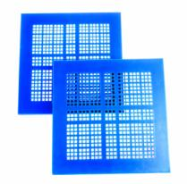
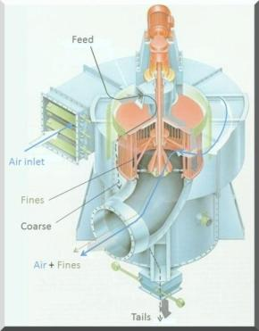
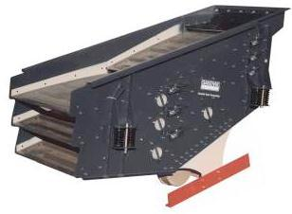
Overview
Mechanical Classification
Screens
Coarse classification (mm)
Air Classification
Classifiers (“Separators”)
Fine classification (μm)

